Slide 1



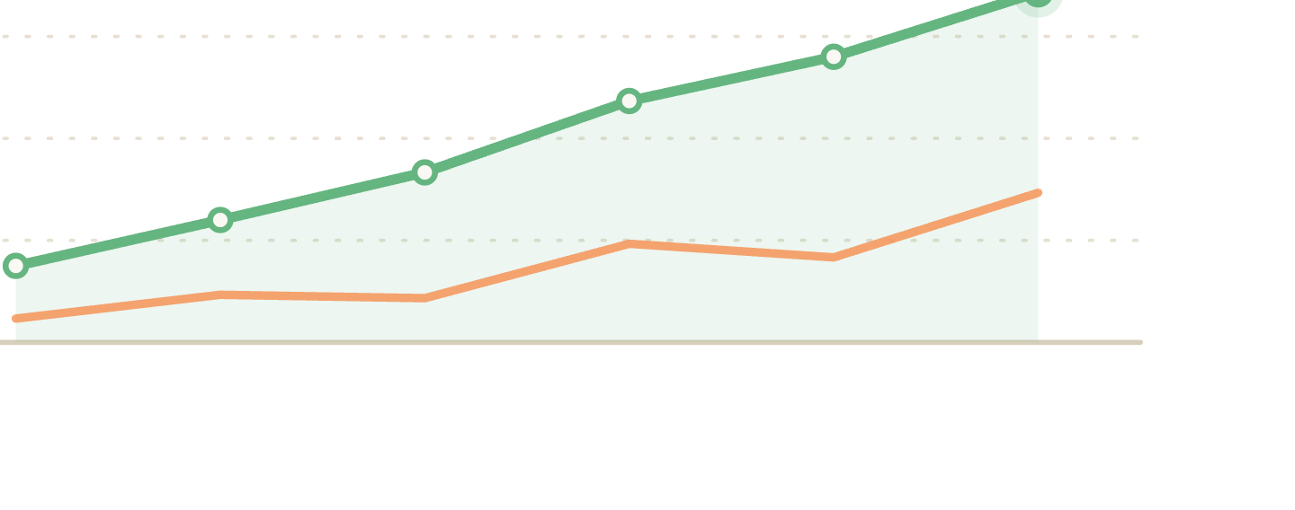
Lesson 2 · Writing
Vocabulary for
trends
.
The exact words examiners look for when data goes up, down, or nowhere at all.
Notes:
Welcome to Lesson 2. This lesson is all about the vocabulary examiners reward when describing trends, the precise verbs and adverbs for up, down, and stable.

Slide 2
WHY THIS MATTERS
One verb can be worth a whole band score.
Examiners reward precise, varied language . If every sentence says "went up" or "went down", your lexical resource score has a ceiling, no matter how accurate your data is.
in this lesson →
01
Describing an increase
02
Describing a decrease
03
Stability & fluctuation
04
Anchoring change in time
Lesson 2 of 6 · IELTS Writing Task 1 · orangeenglish.nl
2
Notes:
Make the stakes clear: lexical resource is a quarter of the Task 1 score. Repeating 'went up / went down' caps it. Preview the four parts of the lesson.

Slide 3
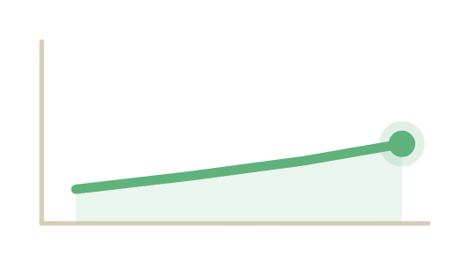
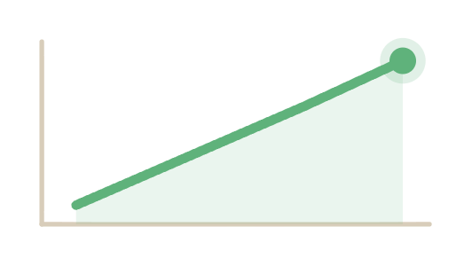

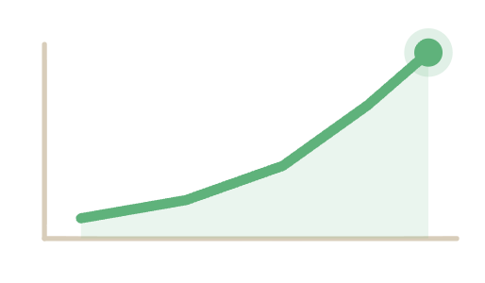

PART 1 · VERBS FOR CHANGE
Describing an increase.
going up ↗
SLIGHT
rose slightly
· edged up · crept up
"Sales rose slightly in March."
STEADY
increased steadily
· grew · climbed
"Profits grew steadily over the decade."
DRAMATIC
surged
· soared · rocketed
"Demand surged after 2018."
Lesson 2 of 6 · IELTS Writing Task 1 · orangeenglish.nl
3
Notes:
Part 1. Three tiers of intensity for going up. The highlighted verbs are the ones to memorise; match the adverb to how steep the line is. Each tier has its own chart.

Slide 4
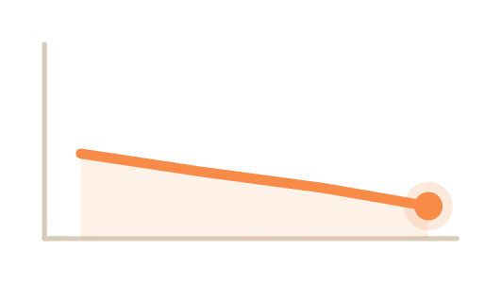
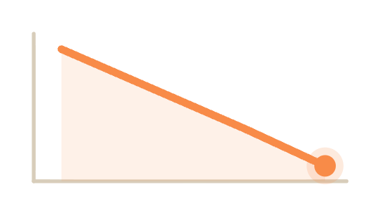
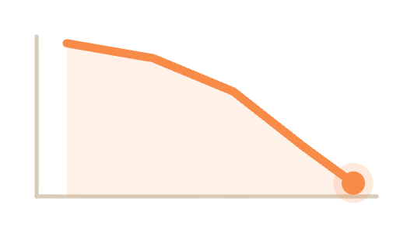
PART 1 · VERBS FOR CHANGE
Describing a decrease.
going down ↘
SLIGHT
dipped slightly
· eased back · edged down
"Prices eased slightly in Q2."
STEADY
declined steadily
· fell · dropped
"Membership fell steadily each year."
DRAMATIC
plummeted
· collapsed · nosedived
"Exports collapsed in 2020."
Lesson 2 of 6 · IELTS Writing Task 1 · orangeenglish.nl
4
Notes:
Part 1 continued. The mirror image for going down. Same three tiers, slight, steady, dramatic, with the matching verbs. Each tier has its own chart.

Slide 5
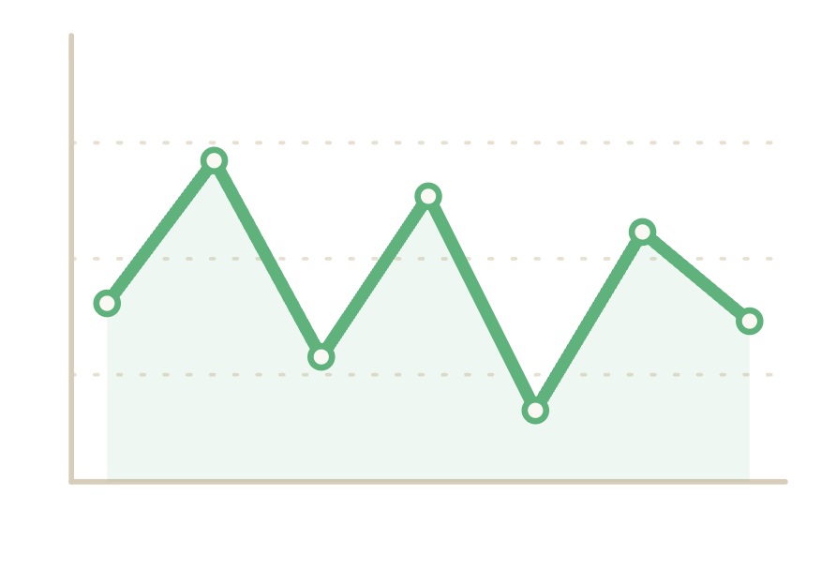
PART 2 · DESCRIBING CHANGE
When the line doesn't go in one direction.
Stability
a fluctuating trend
remained stable · levelled off · plateaued · stayed constant
"Numbers remained stable between 2015 and 2018."
Fluctuation
fluctuated · varied · rose and fell
"Prices fluctuated throughout the period."
up, down, up, down, no clear direction
Lesson 2 of 6 · IELTS Writing Task 1 · orangeenglish.nl
5
Notes:
Part 2. Not every line moves in one direction. Stability verbs for flat lines, fluctuation verbs for jagged ones. Use the side chart to illustrate fluctuation.

Slide 6
PART 3 · TIME EXPRESSIONS
Telling the examiner when it happened.
01
02
03
04
A single point
A period
An ongoing trend
Endpoint
in 2010
between 2010 and 2015
throughout the period
by 2015
at the start of the period
from 2010 to 2015
over the course of the year
by the end of the period
over the decade
by the final year
since 2020
across the decade
Lesson 2 of 6 · IELTS Writing Task 1 · orangeenglish.nl
6
Notes:
Part 3. A verb describes the change; a time expression anchors it. Four kinds: a single point, a period, an ongoing trend, and an endpoint.

Slide 7
examiner mode
From band 5 to band 7, one sentence.
✗
WEAK
"The number of users went up a lot between 2010 and 2020."
vague verb, no precision
✓
STRONGER
"The number of users
between 2010 and 2020."
rose dramatically
, climbing from
2 million to 9 million
varied verb + exact figures included
Lesson 2 of 6 · IELTS Writing Task 1 · orangeenglish.nl
7
Notes:
Examiner Mode. Put it all together: one weak sentence rewritten with a varied verb, an adverb, and exact figures. This is the band 5 to band 7 jump.

Slide 8
ACTIVITY
your turn!
Sort the vocabulary.
Decide whether each word describes an increase, a decrease, or stability.
surged
plummeted
plateaued
climbed
fell
fluctuated
soared
declined
remained stable
↗
INCREASE
↘
DECREASE
→
STABILITY
Lesson 2 of 6 · IELTS Writing Task 1 · orangeenglish.nl
8
Notes:
Activity. Students sort the word bank into three columns, increase, decrease, stability. Do the first one together, then let them finish. The answer key is on the next slide.

Slide 9
ACTIVITY
answer key
How the words sort out.
Three describe direction, two describe stability, and one fits none of them.
↗
INCREASE
↘
DECREASE
→
STABILITY
surged
plummeted
plateaued
climbed
fell
remained stable
soared
declined
fluctuated
the trick word, it describes fluctuation and belongs to none of the three.
Lesson 2 of 6 · IELTS Writing Task 1 · orangeenglish.nl
9
Notes:
Answer key. Walk through the sort: surged, climbed and soared describe an increase; plummeted, fell and declined a decrease; plateaued and remained stable describe stability. The trick word is fluctuated, which describes fluctuation and belongs to none of the three.

Slide 10
KEY TAKEAWAYS
What to carry into your writing.
Vary your verbs, don't repeat "went up / went down" for every graph.
Match the adverb to the trend: slightly, steadily, or dramatically.
Always anchor the data in time, using accurate time expressions.
Precision beats decoration, one well-chosen verb outperforms a long sentence.
next up →
Grammar for Data Description
Lesson 2 of 6 · IELTS Writing Task 1 · orangeenglish.nl
10
Notes:
Recap the four takeaways. Vary verbs, match the adverb, anchor in time, precision over decoration. Preview Lesson 3: Grammar for Data Description.

